Slide 1
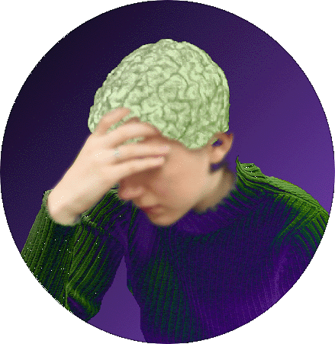
The PICAN EEG Toolkit
Program in Cognitive Affective Neuroscience (PICAN)
Greg Siegle, Ph.D.
Josh Barback, B.S., M.F.A.

Slide 2
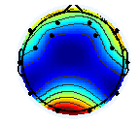
On analyzing EEG
Preprocess (→mV, rescale outliers, etc) (may be done in BESA)
If EEG
Load the data
(Electrodes x samples)
Decompose into frequencies and extract those you want
(Electrodes x samples)
Break the data into trials
(Trials x Electrodes x Samples/Trial)
Average across trials in a condition (Conditions x Electrodes x Samples/Trial)
Group waveform analysis
Extract some parameter e.g., N200
(Conditions x Electrodes)
Group Topology analysis

Slide 3
The PICAN EEG Toolkit
In
\\oacres3\rcn\pican\MatlabCode\PupilToolkit\picaneeg
On Oaclresi: /data/Siegle/matlab/picaneeg
Inherits from and needs to operate:
the Pupil Toolkit
\\oacres3\rcn\pican\MatlabCode\PupilToolkit
EEGlab, an Open Source Matlab Toolbox for Electrophysiological Research
sccn.ucsd.edu/eeglab/

Slide 4
Functions for single subject analysis
 | Function | Explanation
Reading data | picaneeg_loadraw | Loads data from any net
 | picaneeg_addnetdata | Adds electrode placement information
 | picaneeg_biosemi_procevents | Extracts events from the biosemi system
Processing data | picaneeg_noisefilter | Filters data – most useful for ERP
 | picaneeg_indivalphafreq | Finds an individually tailored alpha range
 | picaneeg_segmenttrials | Breaks data up into trials
 | picaneeg_dropbadtrials | Rejects trials outside 75 mV
 | picaneeg_condmeans | gets the trial and condition related averages within some time window
 | picaneeg_getmontageavg | gets the condition related averages for certain electrodes
Plotting | picaneeg_plottimeseries | Shows complete time-series for all electrodes, stacked vertically
 | picaneeg_animtopo | Animates a topographic map over time
 | picaneeg_condtopo | show the condition means on a topographic scalp
 | picaneeg_plotcondmeans | shows condition-related means for all conditions for all or just some electrodes
 | picaneeg_plotallcondtrials | shows all trials

Slide 5
Examples
Single Subject Analyses
picaneegexample_continuousalpha_emotiv
continuous alpha from the EMOTIV system
picaneegexample_N2flanker_biosemi
N2 from the BIOSEMI system
Group analysis
picaneegexample_group_continuousalpha_emotiv
Continuous alpha over many participants – average topomaps

Slide 6
Biosemi N2 Flanker example
function p=picaneegexample_N2flanker_biosemi(fname,graphics)
% example of working with PICAN eeg functions
% for N2 from a flanker task for the BioSemi system
% usage: p=picaneegexample_alphatrials_emotiv;
if nargin<1, fname='C:\greg\papers\cidar\data\erp\eeg\2265_03flanker.bdf'; end
if nargin<2, graphics=1; end
minfilterfreq=.01; maxfilterfreq=30; % hz filters for ERP analyses
starttime=100; endtime=300; peaktime=200; % time offsets for N2
%%%%%%%%%%%%%%%%%%%%%%%%%%%%%%%%%%%%%%%%%%%%%%%%%%%%%%%%
%% Loading the data
p=picanproceeg(fname,0,0); % 0,0 means no frequency data processed
p=picaneegaddnetdata(p); % add electrode placement
p=biosemi_procevents(p); % find event codes
p=picaneegnoisefilter(p,minfilterfreq,maxfilterfreq); % filter from .01 to 30Hz - only for ERP analyses
%%%%%%%%%%%%%%%%%%%%%%%%%%%%%%%%%%%%%%%%%%%%%%%%%%%%%%%%
%% Design Specific Code - MODIFY THIS
% suppose every 2 seconds represents a new window of interest
p.TrialStarts=p.EventTicks(1:2:end);
p.TrialEnds=[p.TrialStarts(2:end) size(p.OtherData,2)];
p.TrialLengths=[p.TrialEnds-p.TrialStarts];
p.TrialTypes=p.EventCodes(1:2:end);
p.CondLabels={'Congruent','Incongruent'};
%%%%%%%%%%%%%%%%%%%%%%%%%%%%%%%%%%%%%%%%%%%%%%%%%%%%%%%%
%% Segmenting the data into trials and getting Condition-Related averages and stats
p=picansegmenteegtrials(p); % breaks the data into trials
%pcolor(p.EEGind); shading flat % shows all electrodes
p=picaneegdropbadtrials(p); % drops bad trials
p=picangeteegtimewin(p,starttime,endtime); % gets the trial and condition related averages between 100 and 300ms
p.selectedtrialavg=picangetmontavg(p,[3 12],'Min'); % gets the condition related averages for certain electrodes, here F3 and F4
%%%%%%%%%%%%%%%%%%%%%%%%%%%%%%%%%%%%%%%%%%%%%%%%%%%%%%%%
%% Plotting functions
if graphics
%figure(1); picanploteegtimeseries(p); % shows time-seriesp.selectedtrialavg=picangetmontavg(p,[3 12],'Mean'); % gets the condition related averages for certain electrodes, here F3 and F4
%figure(2); picananimtopo(p); % animate time series
figure(3); clf; picaneegcondtopo(p); % show the condition means on a topographic scalp
figure(4); clf; picanploteegcondmeans(p); % shows condition-related means for all conditions
% alternately can show just one condition using eeglab native functions
figure(5); clf; plottopo(squeeze(p.CondMeans(1,:,:)),p.chanlocs); % condition 1
figure(6); clf; plottopo(squeeze(p.CondMeans(2,:,:)),p.chanlocs); % condition 2
figure(7); clf; picanploteegcondmeans(p,{'Fz','Cz','Pz','Oz'});
condnum=0; sorttime=peaktime; % sorttime in ms
figure(8); clf; picaneegplotallcondtrials(p,'Fz',condnum,sorttime);
end
%%%%%%%%%%%%%%%%%%%%%%%%%%%%%%%%%%%%%%%%%%%%%%%%%%%%%%%%%
%% writing output
picanwriteeegstats(p,'Min');

Slide 7
Loading data: picaneeg_loadraw - Loads data from any net - minimal outlier rescaling - conversion to frequency domain if requested
function p=picaneeg_loadraw(fname,freqlb,frequb,enet,makesmall, absorrel,graphics,dorescaleoutliers)
% freqlb and frequb are the frequency band to examine with wavelet power
% note - this is NOT a band-pass filter. Rather, a running power
% estimate is returned
% for ERP use freqlb=0, frequb=0
% enet is one of:
% biosemi_bdf
% besa_dat
% emotiv_edf
% makesmall means save only the data used by pican routines
% useful because eeg is so big
% absorrel is one of
% 'abs' - absolute power transformed as log(x)
% 'rel' - relative power transformed as log(x+1)/log(x-1)
% graphics is whether plots are produced
% 1=make plots
% 0=no plots
% dorescaleoutliers
% 1=Windsorize outliers outside Tukey hinges
% 0=don't Windsorize
p=picaneeg_loadraw(fname,8,12);
p =
fname: 'Heaven Day 1 Trial 01.edf'
SampleRate: 128
ChanLabels: {14x1 cell}
EEGind: [14x4608 double]
freqlb: 8
frequb: 12
OtherData: [2x4608 double]
netname: 'emotiv_edf'

Slide 8
Loading data: picaneeg_loadraw - Loads data from any net - minimal outlier rescaling - conversion to frequency domain if requested
function p=picaneeg_loadraw(fname,freqlb,frequb,enet,makesmall, absorrel,graphics,dorescaleoutliers)
% freqlb and frequb are the frequency band to examine with wavelet power
% note - this is NOT a band-pass filter. Rather, a running power
% estimate is returned
% for ERP use freqlb=0, frequb=0
% enet is one of:
% biosemi_bdf
% besa_dat
% emotiv_edf
% makesmall means save only the data used by pican routines
% useful because eeg is so big
% absorrel is one of
% 'abs' - absolute power transformed as log(x)
% 'rel' - relative power transformed as log(x+1)/log(x-1)
% graphics is whether plots are produced
% 1=make plots
% 0=no plots
% dorescaleoutliers
% 1=Windsorize outliers outside Tukey hinges
% 0=don't Windsorize
p=picaneeg_loadraw(fname,0,0);
p =
fname: '2265_03flanker.bdf'
SampleRate: 512
ChanLabels: {128x1 cell}
EEGind: [128x612352 double]
freqlb: 0
frequb: 0
OtherData: [9x612352 double]
netname: 'biosemi_bdf'
Channels x samples

Slide 9
Loading data: picaneeg_addnetdata Adds electrode placement information
>> p.chanlocs(1)
ans =
theta: -39.9930
radius: 0.6107
labels: 'A1'
sph_theta: 39.9930
sph_phi: -19.9206
sph_theta_besa: -109.9206
sph_phi_besa: -50.0070
X: 0.7203
Y: 0.6042
Z: -0.3407
p=picaneeg_addnetdata(p)
fname: ‘2265_03flanker.bdf'
SampleRate: 512
ChanLabels: {128x1 cell}
EEGind: [128x612352 double]
freqlb: 0
frequb: 0
OtherData: [9x612352 double]
netname: 'biosemi_bdf'
chanlocs: [1x128 struct]

Slide 10
Loading data: picaneeg_biosemi_procevents Adds event codes
bar(p.EventTicks(1:200), p.EventCodes(1:200))
p=picaneeg_biosemi_procevents(p);
fname: '2265_03flanker.bdf'
SampleRate: 512
ChanLabels: {128x1 cell}
EEGind: [128x612352 double]
freqlb: 0
frequb: 0
OtherData: [9x612352 double]
netname: 'biosemi_bdf'
chanlocs: [1x128 struct]
EventTicks: [1x1200 double]
EventCodes: [1x1200 double]

Slide 11
Processing data: picaneeg_noisefilter band-pass filters the data
p=picaneeg_noisefilter(p,minfilterfreq,maxfilterfreq);
p=picaneeg_noisefilter(p,.01,30)
plot(p.EEGind(1,1:1000))
p=picaneeg_noisefilter(p,.01,30)
hold on; plot(p.EEGind(1,1:1000),'r')
legend('unfiltered','filtered')
fname: '2265_03flanker.bdf'
SampleRate: 512
ChanLabels: {128x1 cell}
EEGind: [128x612352 double]
freqlb: 0
frequb: 0
OtherData: [9x612352 double]
netname: 'biosemi_bdf'
chanlocs: [1x128 struct]
EventTicks: [1x1200 double]
EventCodes: [1x1200 double]

Slide 12
Segmenting data: Adding trial information
p.TrialStarts=p.EventTicks(1:2:end);
p.TrialEnds=[p.TrialStarts(2:end) size(p.OtherData,2)];
p.TrialLengths=[p.TrialEnds-p.TrialStarts];
p.TrialTypes=p.EventCodes(1:2:end);
p.CondLabels={'Congruent','Incongruent'};
bar(p.TrialTypes(1:100))
fname: 'C:\greg\papers\cidar\data\erp\eeg\2265_03flanker.bdf'
SampleRate: 512
ChanLabels: {128x1 cell}
EEGind: [128x612352 double]
freqlb: 0
frequb: 0
OtherData: [9x612352 double]
netname: 'biosemi_bdf'
chanlocs: [1x128 struct]
EventTicks: [1x1200 double]
EventCodes: [1x1200 double]
TrialStarts: [1x600 double]
TrialEnds: [1x600 double]
TrialLengths: [1x600 double]
TrialTypes: [1x600 double]
CondLabels: {'Congruent' 'Incongruent'}
# trials

Slide 13
Segmenting data: picaneeg_segmenttrials breaks data into trials
p=picaneeg_segmenttrials(p)
fname: 'C:\greg\papers\cidar\data\erp\eeg\2265_03flanker.bdf'
SampleRate: 512
ChanLabels: {128x1 cell}
EEGind: [128x612352 double]
freqlb: 0
frequb: 0
OtherData: [9x612352 double]
netname: 'biosemi_bdf'
chanlocs: [1x128 struct]
EventTicks: [1x1200 double]
EventCodes: [1x1200 double]
TrialStarts: [1x600 double]
TrialEnds: [1x600 double]
TrialLengths: [1x600 double]
TrialTypes: [1x600 double]
CondLabels: {'Congruent' 'Incongruent'}
EEGTrialData: [600x128x507 double]
plot(squeeze(p.EEGTrialData(1:5,1,:))')
Trials x channels x samples/trial

Slide 14
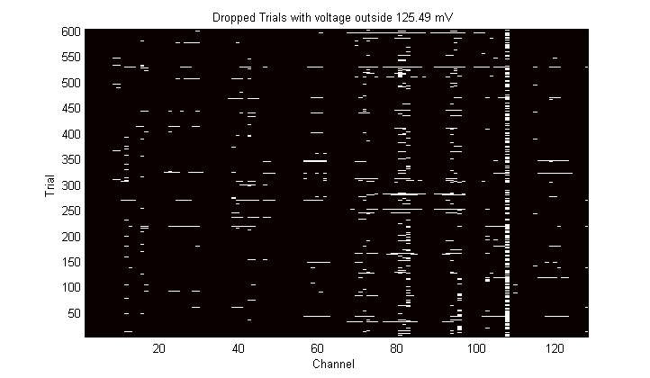
Segmenting data: picaneeg_dropbadtrials Drops trials outside the Tukey Hinges
p=picaneeg_dropbadtrials(p);
fname: 'C:\greg\papers\cidar\data\erp\eeg\2265_03flanker.bdf'
SampleRate: 512
ChanLabels: {128x1 cell}
EEGind: [128x612352 double]
freqlb: 0
frequb: 0
OtherData: [9x612352 double]
netname: 'biosemi_bdf'
chanlocs: [1x128 struct]
EventTicks: [1x1200 double]
EventCodes: [1x1200 double]
TrialStarts: [1x600 double]
TrialEnds: [1x600 double]
TrialLengths: [1x600 double]
TrialTypes: [1x600 double]
CondLabels: {'Congruent' 'Incongruent'}
EEGTrialData: [600x128x507 double]
dropcutoff: 125.4937
dropmatrix: [600x128 logical]
Bad channel
Trials x channels

Slide 15
Averaging data: picaneeg_condmeans gets condition-means and condition- and trial-related stats
p=picaneeg_condmeans(p,winstart,winend)
p=picaneeg_condmeans(p,100,300)
fname: 'C:\greg\papers\cidar\data\erp\eeg\2265_03flanker.bdf'
SampleRate: 512
ChanLabels: {128x1 cell}
EEGind: [128x612352 double]
freqlb: 0
frequb: 0
OtherData: [9x612352 double]
netname: 'biosemi_bdf'
chanlocs: [1x128 struct]
EventTicks: [1x1200 double]
EventCodes: [1x1200 double]
TrialStarts: [1x600 double]
TrialEnds: [1x600 double]
TrialLengths: [1x600 double]
TrialTypes: [1x600 double]
CondLabels: {'Congruent' 'Incongruent'}
EEGTrialData: [600x128x507 double]
dropcutoff: 125.4937
dropmatrix: [600x128 logical]
winstart: 100
winend: 300
TrialStats: [1x1 struct]
CondMeans: [2x128x507 double]
CondStats: [1x1 struct]
plot(squeeze(p.CondMeans(:,1,:))')
>> p.CondStats
ans =
CondMean: [2x128 double]
CondMax: [2x128 double]
CondMin: [2x128 double]
Conds x channels
conds x channels x samples

Slide 16
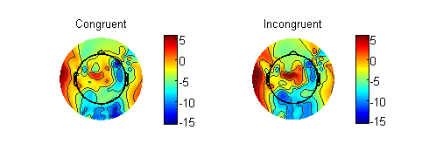
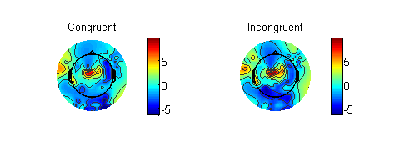
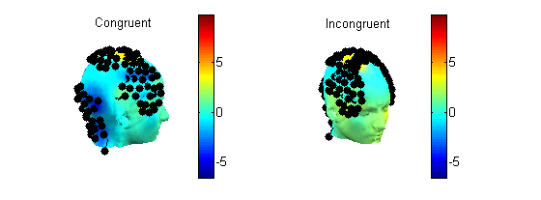
Plotting data: picaneeg_condtopo plots topography of condition-related stats
picaneeg_condtopo(p,’Min’);
Note – must redo Biosemi electrode placement…
picaneeg_condtopo(p,'Mean');
picaneeg_condtopo(p,'Mean',1);

Slide 17
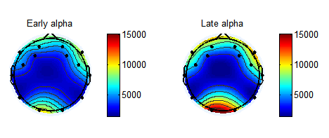
Plotting data: picaneeg_condtopo plots topography of condition-related stats
picaneeg_condtopo(p,'Mean');
Electrode placement is correct for the Emotive system
Note: From
p=picaneegexample_continuousalpha_emotiv

Slide 18
Plotting data: plottopo plots topography of condition-related waveforms
plottopo(squeeze(p.CondMeans(1,:,:)),p.chanlocs);
Note – must redo Biosemi electrode placement…
Note: Negative plotted up

Slide 19
Plotting data: picaneeg_plotcondmeans plots condition-related waveforms
picaneeg_plotcondmeans(p,{'Fz','Cz','Pz','Oz'});
picaneeg_plotcondmeans(p, chanlist);
If chanlist is not specified all channels are plotted…
N2
N2
Note: negative plotted up for ERP

Slide 20
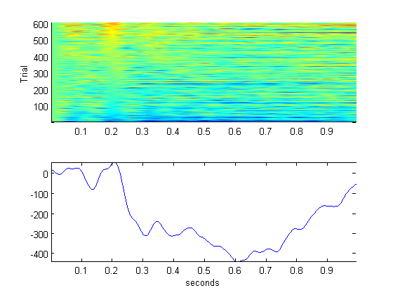
Plotting data: picaneeg_plotallcondtrials plots all trials in a condition sorted by values at some time point
picaneeg_plotallcondtrials(p, channame,condnum,sorttime)
picaneeg_plotallcondtrials(p,'Fz',0,200);
% if condnum is 0, the mean of all conditions is plotted.
% otherwise trials in only one of the conditions is plotted
% sorttime is in ms
The only function where positive is plotted up

Slide 21
Group Analysis
Group analysis means aggregating either parameters or waveforms
To aggregate parameters, you can
save them out to a text file and analyze them elsewhere, e.g., SPSS
Analyze whole scalps accounting for spatial multiple comparisons
To aggregate waveforms
But must account for spatial as well as temporal multiple comparisons

Slide 22
Group Topological Analysis: picaneeg_writestats writes statistics per participant for analysis off-line, e.g., in SPSS
picaneeg_writestats(p,’Mean’)
Writes a text file with 1 value per channel
6ft7ft Day 4 Trial 01_EEGStats_Mean_9-13Hz_4-3500ms.txt
fname AF3_Alpha F7_Alpha F3_Alpha FC5_Alpha T7_Alpha P7_Alpha O1_Alpha O2_Alpha P8_Alpha T8_Alpha FC6_Alpha F4_Alpha F8_Alpha AF4_Alpha
6ft7ft Day 4 Trial 01.edf 2606.1100 4070.1027 1867.2047 2281.4342 1274.5297 1211.2688 1660.8302 1894.0319 1219.4233 1709.9656 2964.3286 2450.2248 5160.7156 2456.1600
Conds x channels
>> p.CondStats
ans =
CondMean: [2x128 double]
CondMax: [2x128 double]
CondMin: [2x128 double]

Slide 23
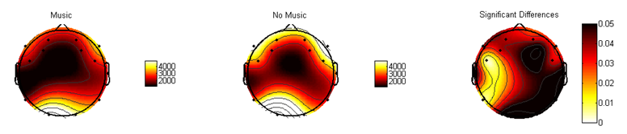
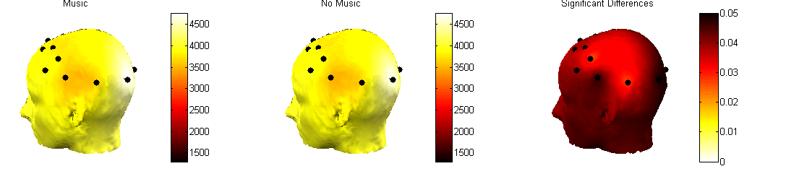
Group Topological Analysis: picaneeg_groupdiff plots group differences in topology
pall=picaneeg_groupdiff(pall,doaspaired,showhead,winstart,winend)
picaneeg_groupdiff(pall);
pall = picaneeg_
example_
group_
continuousalpha_
emotiv
pall =
GroupLabels: {'Music' 'No Music'}
SampleRate: 128
ChanLabels: {14x1 cell}
chanlocs: [1x14 struct]
netname: 'emotiv_edf'
winstart: 4
winend: 3500
EEGsummary: [40x14 double]
EEG: [4-D double]
group: [1x40 double]
EEGsummary_grpdiff_t: [1x14 double]
EEGsummary_grpdiff_p: [1x14 double]
picaneeg_groupdiff(pall,1); % the 1 says put it on a head
Yes, you can rotate it….
Notes:
pall = picaneeg_example_group_continuousalpha_emotiv

Slide 24
But how do we control type I error across electrodes?
A priori
Identification of electrodes of interest
To claim localization:
Cluster thresholding as in fMRI
To not care about localization:
# electrodes necessary for you to say the groups are different

Slide 25
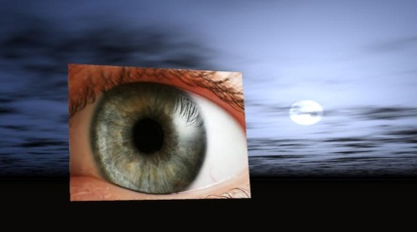
Comparing waveforms
The Pupil Toolkit
Comparing waveforms is not trivial
We have implemented functions for computing tests at every sample along the waveform.
Unless these comparisons are a-priori I recommend using these only in the context of a group x time or condition x time interaction done on a dimension-reduced dataset.
Controlling type I error
Guthrie & Buchwald’s (1991) technique
Guthrie D, Buchwald JS (1991): Significance testing of difference potentials. Psychophysiology 28:240-244.
Blair & Karniski’s (1993) technique
Blair RC, Karniski W (1993): An alternative method for significance testing of waveform difference potentials. Psychophysiology 30:518-524

Slide 26
T-tests at every sample, marking intervals significantly long enough to care about via Guthrie & Buchwald (1991)
The Pupil Toolkit
What’s the emotion?
UGLY
0.3
Never Depressed (41)
Unmedicated Depressed (47)
mm
0.2
0.1
0
5
10
15
20
25
seconds
Regions of significant differences. Yellow is p<threshold you pass as an argument (p<0.1 by default) and red is less than p<.05. The black line is intervals longer than the patch length you pass in.

Slide 27
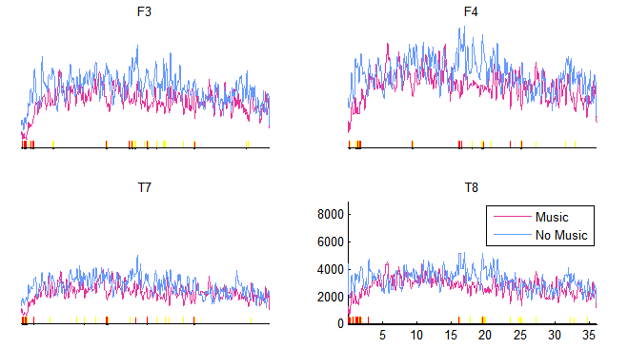
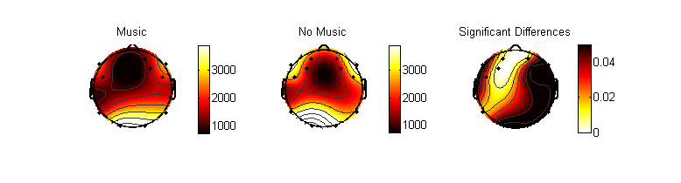
Group Waveform Analysis: picaneeg_groupdiffwaveform plots condition-related waveforms with group differences highlighted
Note: Can use regions of significant differences to remake topographic plots, e.g.,
picaneeg_groupdiff(pall,0,0,300,1000)
picaneeg_groupdiffwaveform(pall,{'F3','F4','T7','T8'})
Ngrp1=20, Ngrp2=20
0.05 to 0.45s: t(38)=-3.67, p=0.00, D=-1314.87, d=-1.16
0.70 to 0.90s: t(38)=-2.35, p=0.02, D=-1364.89, d=-0.74
1.11 to 2.08s: t(38)=-3.52, p=0.00, D=-1876.14, d=-1.11
3.00 to 3.13s: t(38)=-2.06, p=0.05, D=-2218.12, d=-0.65
16.07 to 16.31s: t(38)=-2.01, p=0.05, D=-2358.83, d=-0.64
19.45 to 19.78s: t(38)=-2.35, p=0.02, D=-2033.34, d=-0.74
19.83 to 20.05s: t(38)=-2.24, p=0.03, D=-1734.89, d=-0.71
25.10 to 25.26s: t(38)=-2.39, p=0.02, D=-1647.15, d=-0.76
32.70 to 32.84s: t(38)=-2.11, p=0.04, D=-1803.47, d=-0.67
Stats too…

